Slide 1
DATA ANALYTICS APPROACH TO SEGEMENT CUSTOMER BASED ON THEIR INTERESTS

Slide 2
agenda
Abstract
Problem Definition
Proposed Solution
Development Environment
Deployment Environment
Future Scope
Conclusion

Slide 3
abstract
In today's competitive market, customer segmentation is one of the most important aspects of a business decision support system.
Customer segmentation is a way to group customers into different segments based on some common characteristics.
Here, customer’s behaviour is learnt using machine learning techniques.
This customer segment project is being developed using some unsupervised machine learning algorithm used to cluster the data into various clusters.

Slide 4
Abstract(cOntd..)
By segmenting the customers, we can come to know better about the customers and their needs.
It helps in providing a profitable business.

Slide 5
Problem definition
Customers are of different character and have different needs.
By following different strategies to attract different customers according to their interests or needs a company can earn more profit.
For applying different strategies here is the approach to segment the customers based on their interests.
Customer segmentation helps a company to identify the difference between the customers which will be easier to meet their customer needs and take care of customers who are of high importance for their company.

Slide 6
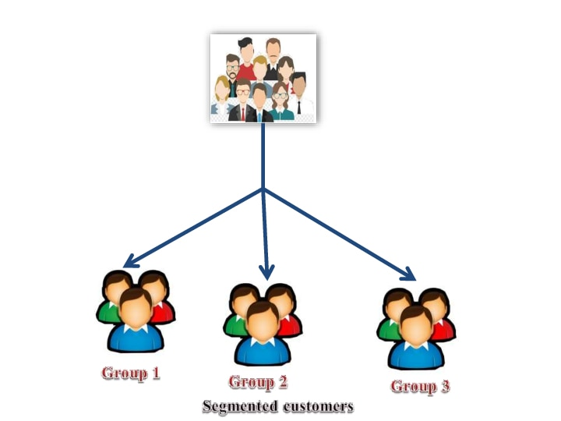
PROBLEM definition(contd…)

Slide 7
Proposed solution
After preprocessing of the data set , RFM (Recency, Frequency, Monetary) score is calculated.
By applying unsupervised algorithm such as K-means algorithm the customers are made as clusters.
According to the clusters, the company can frame their strategies to attract their customers.

Slide 8
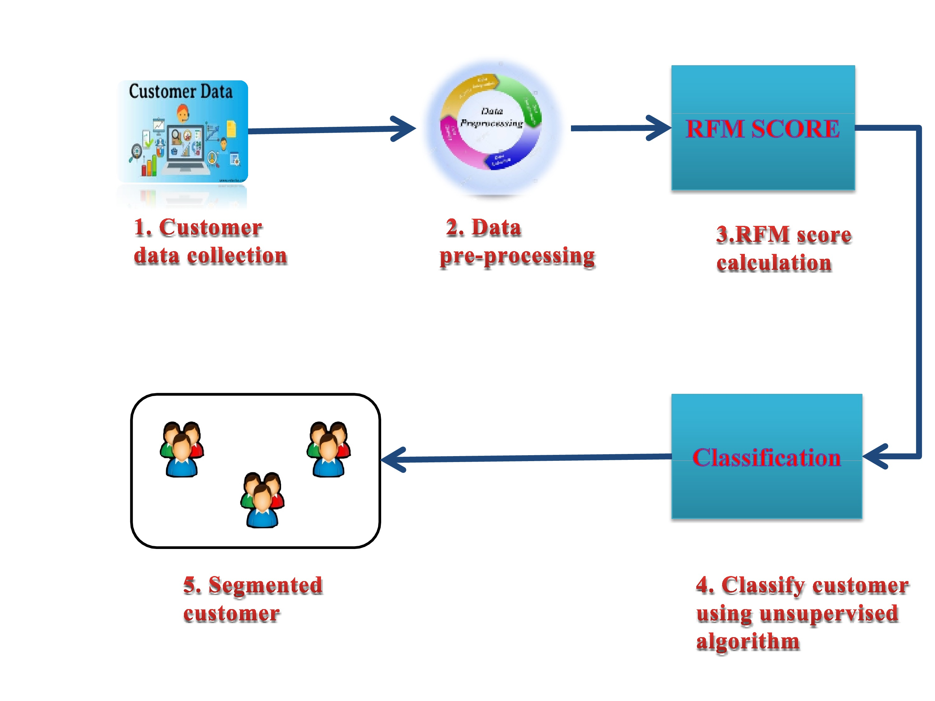
Proposed solution(contd…)

Slide 9
DEVELOPMENT ENVIRONMENT
Development language: Python
IDE: Jupyter Notebook
Algorithms : K-means algorithm

Slide 10
Future scope
Customer satisfaction is an main criteria so the company can satisfy the customers by segmenting them and analyzing their needs.
Customer segmentation can help a company to improve their profit and number of loyal customers
Customer segmentation helps the company for making decision about the products.

Slide 11
Conclusion
In this competitive world every business corporation should apply some strategies for attract their customers. If you properly manage the best current customer segmentation process, however, the impact it can have on every part of your organization - sales, marketing, product development, customer service, etc. — is immense.

